Slide 1






Predicting Patient Survival
Brinda Asuri, Pranav Garg, Soham Bidyadhar, Grayson Merritt, Tom Starkie

Slide 2








Meet the Team
Grayson Merritt
Pranav Garg
Tom Starkie
Soham Bidyadhar
Brinda Asuri

Slide 3




Overview of Content
01
Introduction/Background
02
Data Collection/EDA
03
Data Preprocessing
04
Modeling
05
Lessons/Conclusion

Slide 4


01
Introduction

Slide 5

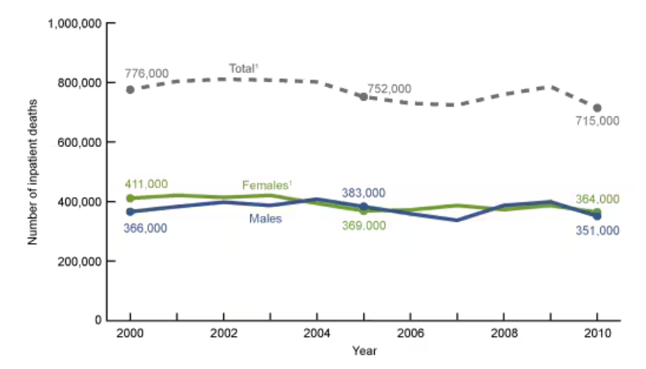

Patient Survival Problem
Accurate mortality predictions are essential for timely medical interventions and optimal resource allocation to enhance patient care
Mortality risks vary across ICUs due to differences in staffing, resources, and local healthcare practices.
Existing research lacks globally applicable severity scoring systems that generalize well across diverse ICU datasets
Traditional severity scoring systems like APACHE are widely used but show calibration issues across different healthcare settings
Despite an 8% decrease in patient hospital deaths from 2000 to 2010, over 700,000 patients died in U.S. hospitals in 2010

Slide 6




Project Goal
Develop a robust machine learning model to accurately predict hospital deaths using comprehensive international critical care data
Create a universally applicable severity of illness scoring system that performs reliably across diverse healthcare settings and countries

Slide 7



02
Data Collection
&
EDA

Slide 8




Data Collection
Where does our data come from?
Data comes from the GOSSIS Consortium members from Argentina, Australia, New Zealand, Bangladesh, India, Nepal, Sri Lanka, Brazil, and the United States
Pooled critical care data from over 385 hospitals, encompassing 380,280 patients across multiple countries
A subset of patient data made its way to Kaggle - 91,713 rows
What type of data was collected?
Collected comprehensive patient information, including vital signs, laboratory results, admission diagnoses, Glasgow Coma Scale scores, chronic comorbidities, and demographic variables
Focused on data gathered within the first 24 hours of ICU admission to capture early indicators of illness severity

Slide 9


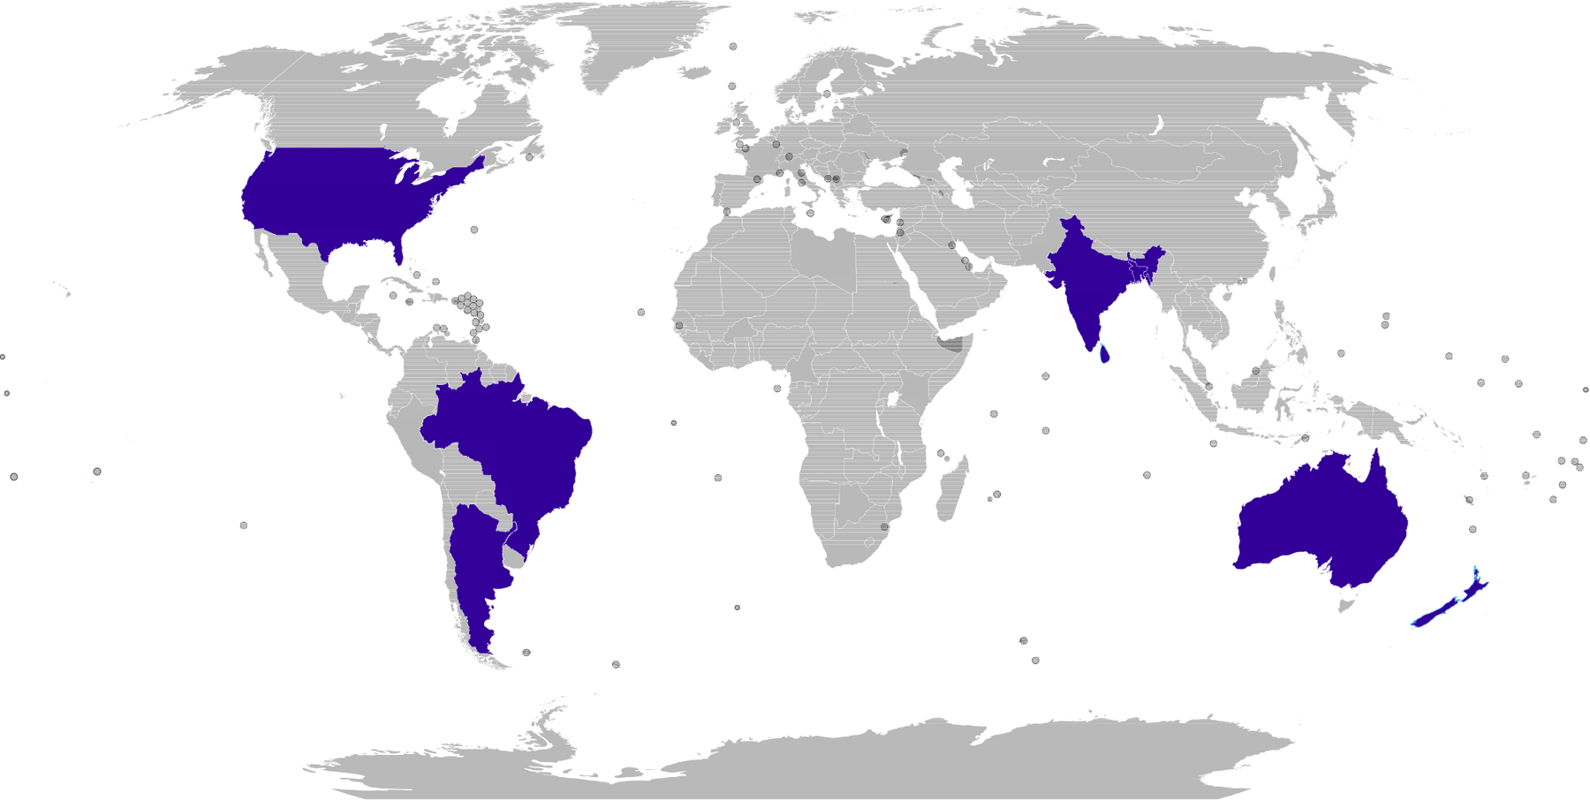

Countries in Dataset

Slide 10

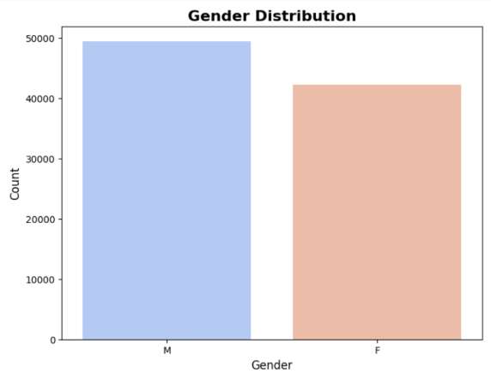
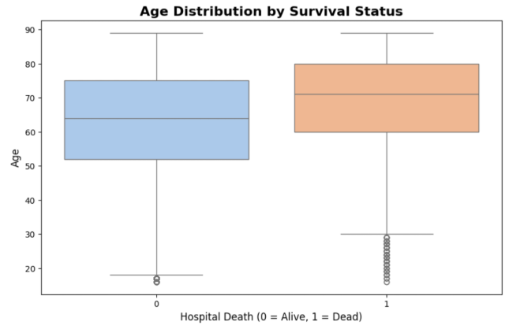
EDA - Age and Gender Distribution

Slide 11
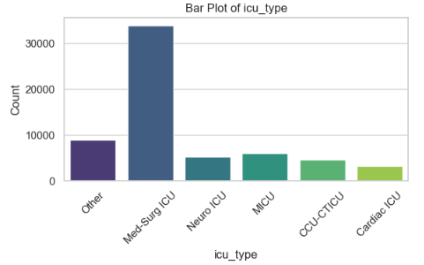
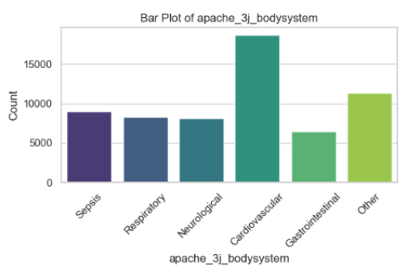
EDA - Categorical Features

Slide 12





03
Data Pre-Processing

Slide 13


Data Cleaning
Dropped ID and blank columns
Save APACHE predictions for comparison later
Missing values were random - dropped them to keep things simpler
Experimented with imputation using KNN - more time, same results
Notes:
-we began by removing any unnecessary columns, such as the ID and blank columns, as they didn’t provide any meaningful information for our analysis.
-save the APACHE predictions for later use. These predictions will serve as a benchmark for comparison as we evaluate the performance of our models.
-Regarding missing values, after a detailed analysis, we found that the missing data appeared to be random. To simplify the workflow, we chose to drop these missing values rather than imputing them.
-We also experimented with imputing the missing values using the K-Nearest Neighbors (KNN) method. Interestingly, this approach did not improve the results compared to dropping the values. Moreover, it required more computational time, so we stuck with the simpler and more efficient approach of dropping them.

Slide 14

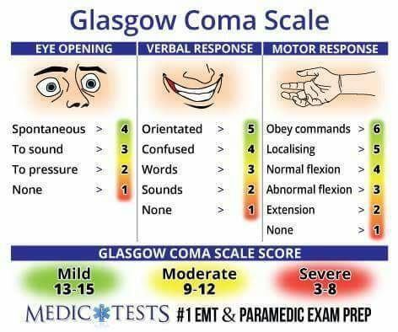
Data Feature Engineering
Initial feature interactions did not add much to metrics
+ want to avoid curse of dimensionality
Collapsed Comorbidity and Glasgow Coma Scale features into a total variable for each
Unimportant categories that are less than 10% are collapsed into “other”.
Ex. - “SICU” into “Other”
Scale using StandardScaler to ensure all features contribute equally for models sensitive to scale
Notes:
-one of our most important variables GCS - will show later
-talk about how we collapsed those variables into one
-ICU admits, ethnicity, and some other mimportant categories were collapsed into other
-standard scale
-models where we need to scale we used the scaled data, and for the models of where we didnt need to scale, we did not use that
- Initially, we explored creating feature interactions, such as combining different variables to see if they added predictive power. However, these interactions did not significantly improve our metrics. Additionally, we were cautious about the curse of dimensionality, which can arise when too many features are added, potentially making the model less effective.
-Next, we simplified the data by collapsing related features. For example, we aggregated the comorbidity features and the Glasgow Coma Scale into a single total score. This made the dataset more streamlined and easier to interpret.
-For categorical variables, we grouped less frequent categories—those representing less than 10% of the data—into an ‘Other’ category. A practical example of this was combining the SICU category into the broader ‘Other’ label.
-Finally, to ensure all features contributed equally to the model, especially those sensitive to scale, we applied the StandardScaler. This step normalized the features to have a mean of 0 and a standard deviation of 1.

Slide 15
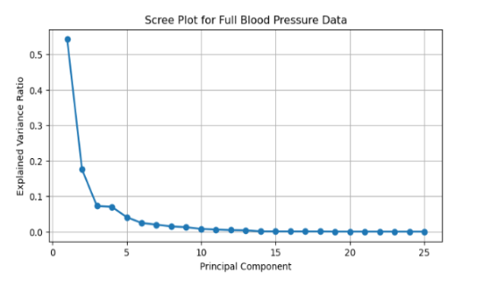
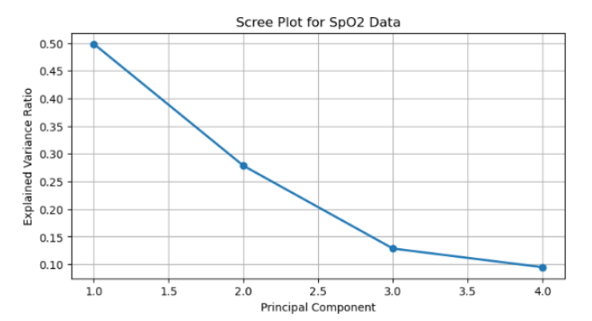
PCA to the Rescue!
Lots of physiological variables, and we wanted to to reduce dimensionality
Used PCA on each subgroup (blood pressure, heart rate, etc.)
Elbow Scree Plot is 🔑
Notes:
-ex. 30 variables with blood pressure,
-first hour, first day,
-min, mean, max of all variables
-half of our features were this, and we wanted to lessen these features
ex: 5 features covered the explained vairance for blood pressure out of 25 features
One of the key challenges we faced was dealing with the large number of physiological variables in our dataset. This high dimensionality not only made the data more complex but also risked overfitting. To address this, we turned to Principal Component Analysis, or PCA.
We applied PCA to different subgroups of variables—such as blood pressure, heart rate, and others—rather than applying it to the entire dataset at once. This allowed us to capture the most important patterns within each group while keeping the transformations interpretable.
The Elbow Scree Plot was our guide here. These plots help us identify the number of principal components to retain by finding the 'elbow point,' where adding more components yields diminishing returns in explained variance. For example, as shown in the blood pressure plot, the variance drops sharply after the first two components, suggesting that we can represent most of the information with just a few key components.
By reducing dimensionality, we not only simplified our model but also retained the most critical information, ensuring that our analysis remained robust and efficient

Slide 16





83 44
Features
Features
Dimensionality Reduced...

Slide 17


Label Encoding Example
ICU_stay_type
admit
0
re-admit
1
transfer
2
Notes:
-ICU stay type for example could be three things, and in order for some models to work we didnt know the difference, so we had to label encode

Slide 18


04
Models

Slide 19

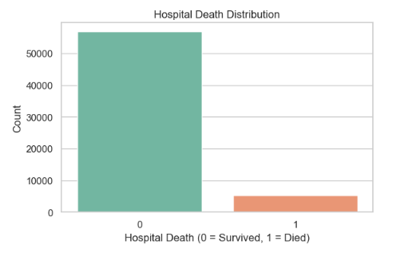

We have a data problem...
Notes:
8.5% of our dataset died, and the rest survived
Without addressing it, the models could become biased toward predicting the majority class because it minimizes error in the short term. However, this would fail to capture the critical patterns that identify higher-risk patients.

Slide 20
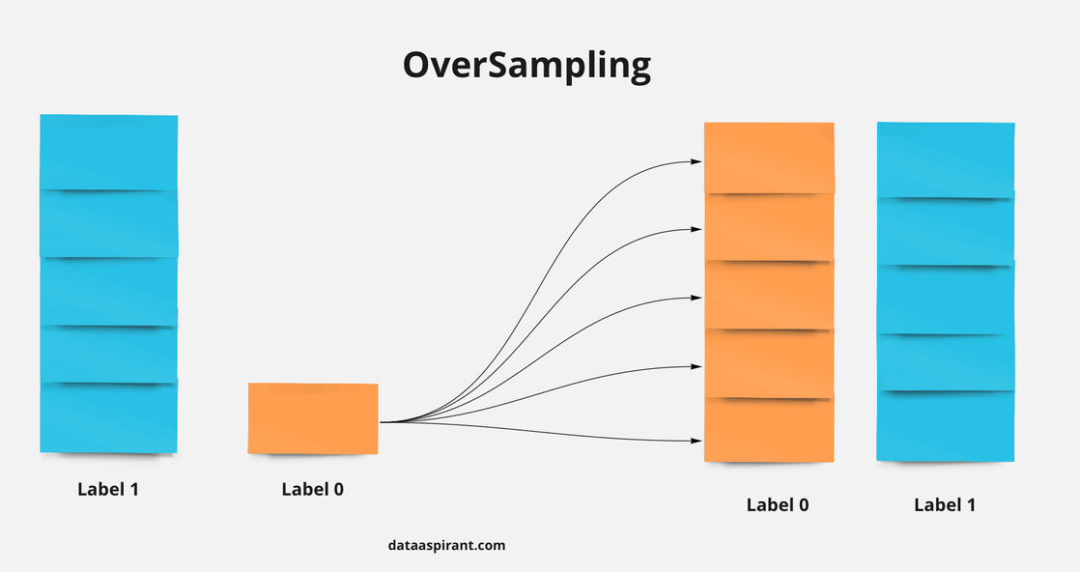
Data Balancing
STRATEGY 1:
Do Nothing
STRATEGY 2:
Use SMOTENC
STRATEGY 3:
Adjust Class Weights
Pros:
Balances class distribution
Improves minority class performance
Cons:
Increased computational load
Potential introduction of noise
Pros:
Simple
Preserves original data distribution
Cons:
Model bias towards majority class
Poor minority class metrics
Pros:
Address imbalance without changing data size
Encourages model to focus on minority class
Cons:
Less intuitive interpretability
Potential impact on majority class performance
Notes:
sythentic minority oversampling technique for nominal and continous
-after using NC - designed to handle more categorical
-by adjusting the weights it leans more towards guessing death
-penalize misclassification in the minority class
-paramters -> class weights that adjusts automatically for you
Strategy 1: Do Nothing
-simple and preserves the original data distribution, which can be important for understanding real-world scenarios.
-significant downside: the model tends to become biased toward the majority class, leading to poor performance on minority class metrics.
Strategy 2: Use SMOTENC
SMOTENC, or Synthetic Minority Oversampling Technique for Nominal and Continuous features, helped us balance the class distribution by synthetically creating new data points for the minority class. This approach improved the model's ability to identify minority class cases. However, it introduced the risk of adding noise, as the synthetic data might not perfectly represent real-world scenarios.
Strategy 3: Adjust Class Weights
In this approach, we modified the model’s loss function to assign higher weights to the minority class. This allows the model to focus more on correctly predicting minority outcomes, without altering the dataset size. While this method is computationally efficient and doesn’t introduce noise, it can sometimes make the results less intuitive and impact the performance on the majority class.

Slide 21
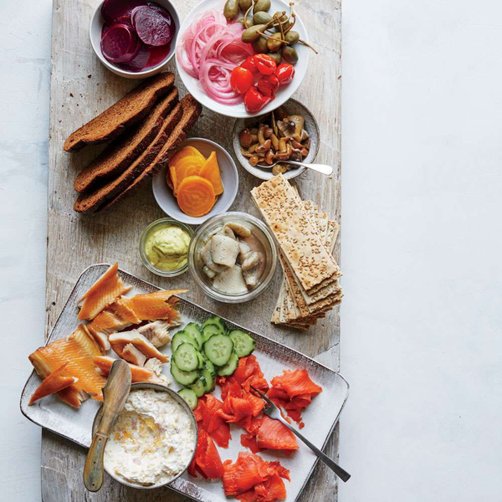
A Smorgasbord of Models
9 model types * 3 strategies
= 27 models to train
Bagging? ✔️
Boosting? ✔️
Naïve Bayes? ✔️
Neural Nets? ✔️
K Cross Fold Validation? ✔️
Adjusting Thresholds? ✔️
Hypertuning? ❌
Feature Importance? ✔️
Crazy? ✔️

Slide 22
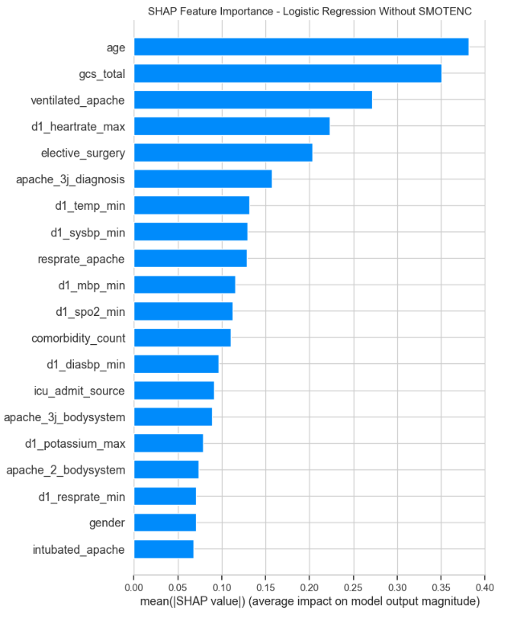

Logistic Regression: Class Weights
Lasso Regression with a C of .1
Accuracy: .781
Recall: .766
Precision: .244
F1-Score: .370
ROC AUC: .854
PR AUC: .382
Notes:
“We might need to see high recall in our case because we want the patients who truly need critical care to be identified, even at the cost of increasing false positives, as missing these patients (low recall) could have severe consequences.”
C is a hyperparameter
we used L1 Lasso here
c = inverse of lamba
it means smaller c is more regularization

Slide 23

Decision Tree - No SMOTENC
Accuracy: .874
Recall: .311
Precision: .279
F1-Score: .386
ROC AUC: .618
PR AUC: .324

Slide 24
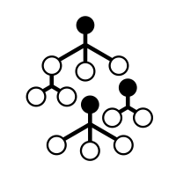
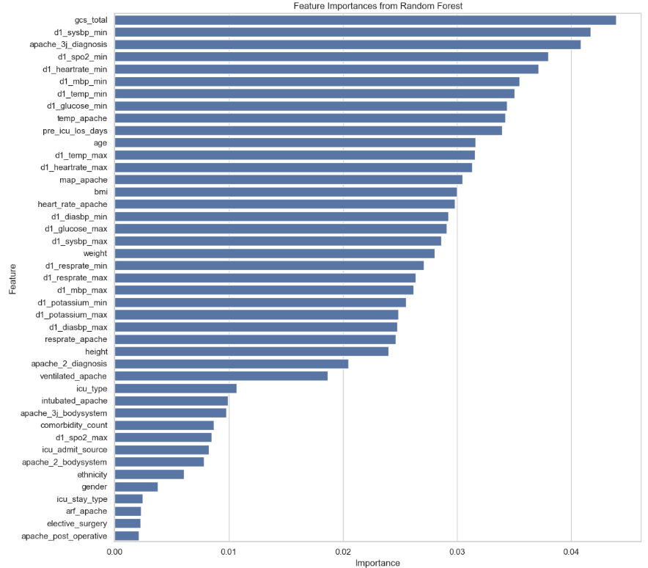

Random Forests: SMOTENC
Accuracy: .896
Recall: .386
Precision: .386
F1-Score: .386
ROC AUC: .849
PR AUC: .346
Recall at 90%
Threshold: .16
Precision: .176
F1-Score: .295

Slide 25
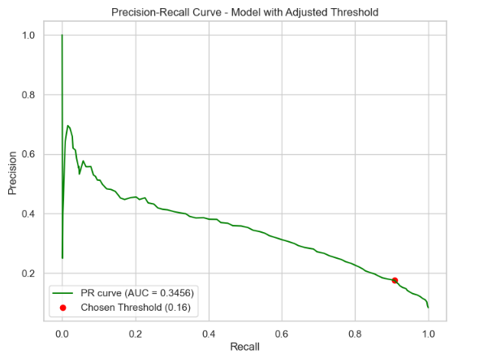
Brief Intro to Threshold Adjusting
Definition Reminders
Decision Threshold: The probability cutoff point at which the model assigns a sample to a particular class. By default, this is often set at 0.5
Recall for Class 1: The ability of the model to correctly identify all actual positive instances (i.e., patients who will experience hospital death)
OUR GOAL: Lower False Negatives
Threshold ⬇️
Predicted Positive ⬆️
Recall ⬆️ (True Positive Rate)
Precision ⬇️ (Increase False Positives)
Accuracy ⬇️
Results in more false alarms, but can also provide more critical care for those who need it, ensuring that we do not miss any actual positive cases, even if it means allocating additional resources to review and manage these cases.
Notes:
In healthcare, the cost of a false negative (e.g., not predicting a patient’s need for urgent care) is much higher than the cost of a false positive (e.g., providing extra care unnecessarily).
We would want more false alarms as it will give us more patients flagged for potential critical care, ensuring that we do not miss any actual positive cases, even if it means allocating additional resources to review and manage these cases.

Slide 26
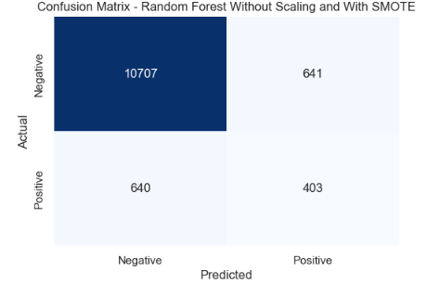
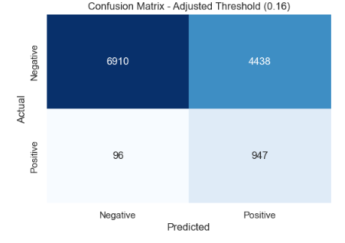
Changing Thresholds Results
Shift to predicting more positives
Want this low

Slide 27

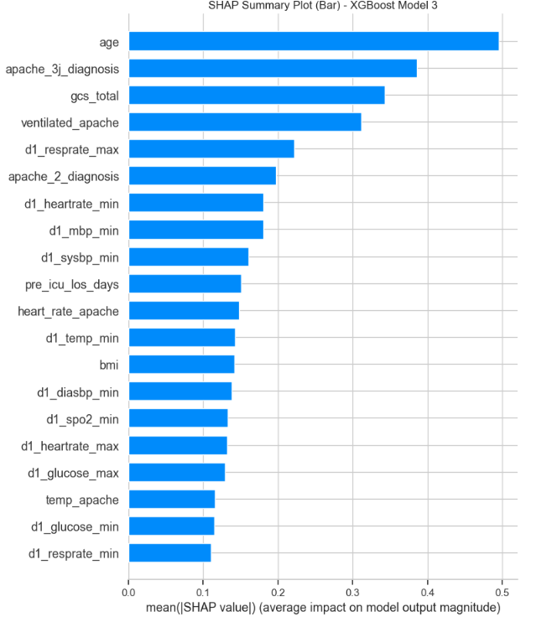
XGBOOST: Class Weights
Accuracy: .869
Recall: .585
Precision: .339
F1-Score: .429
ROC AUC: .852
PR AUC: .421
Recall at 90%
Threshold: .09
Precision: .163
F1-Score: .277

Slide 28

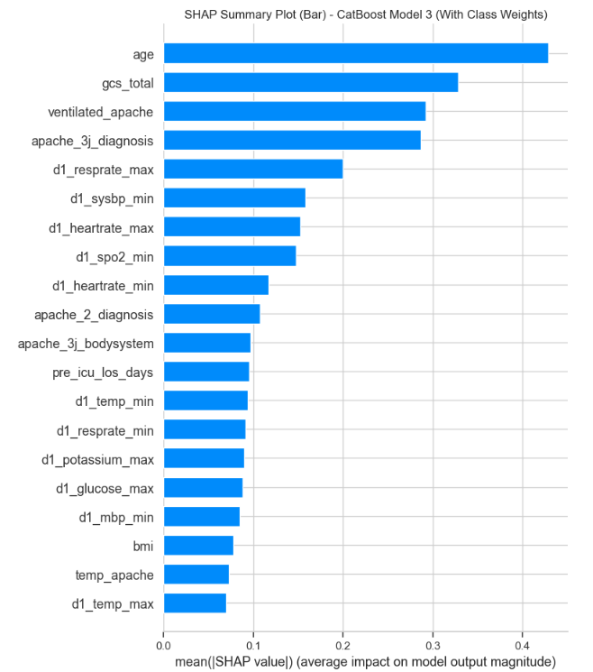
CATBoost: Class Weights
Accuracy: .812
Recall: .758
Precision: .276
F1-Score: .405
ROC AUC: .857
PR AUC: .455
Recall at 90%
Threshold: .29
Precision: .191
F1-Score: .315
Notes:
Yandex created the Catboost

Slide 29


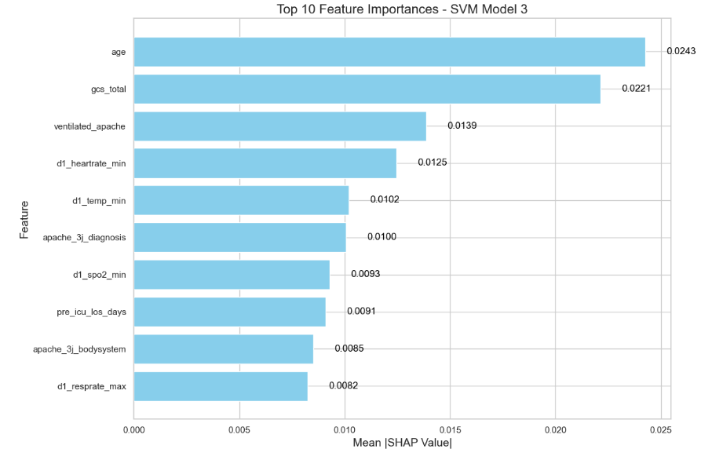
Support Vector Machines: Class Weights
Accuracy: .838
Recall: .674
Precision: .297
F1-Score: .412
ROC AUC: .857
PR AUC: .368
Recall at 90%
Threshold: .04
Precision: .170
F1-Score: .286

Slide 30

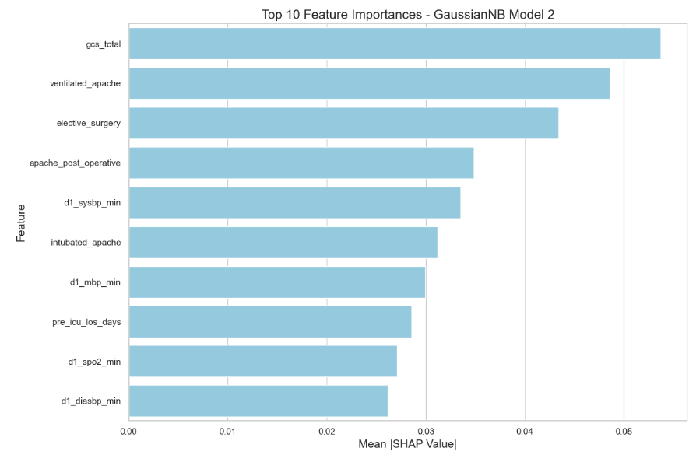
Gaussian Naïve Bayes: SMOTENC
Accuracy: .771
Recall: .700
Precision: .224
F1-Score: .339
ROC AUC: .795
PR AUC: .326

Slide 31
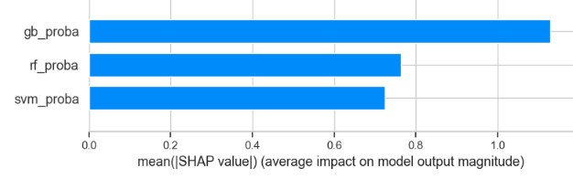
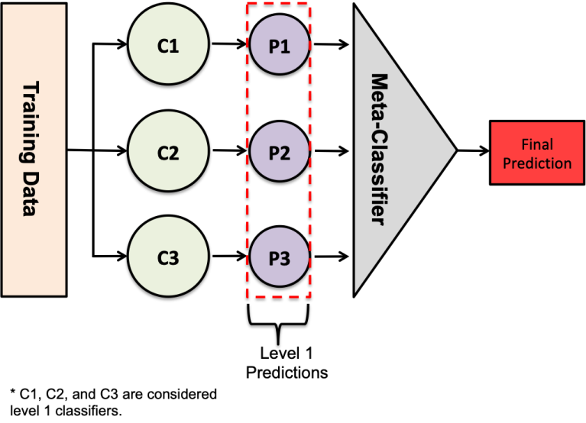
Stacking Classifier: Class Weights
Accuracy: .956
Recall: .946
Precision: .965
F1-Score: .955
ROC AUC: .990
PR AUC: .992
Best metrics, but takes forever and not intuitive to interpret

Slide 32
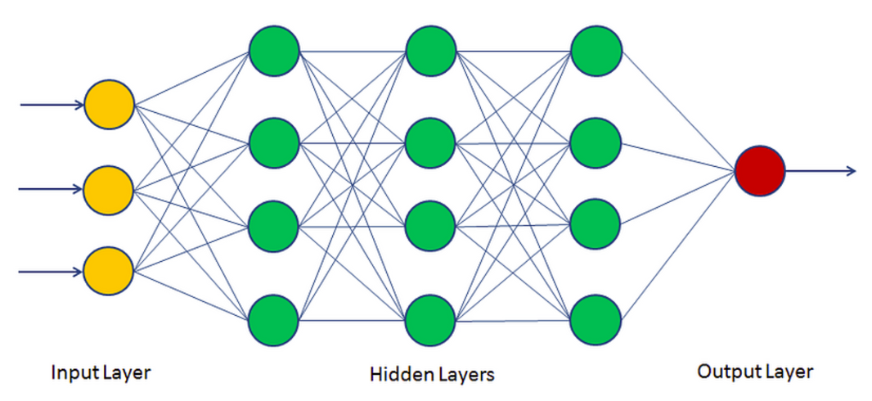
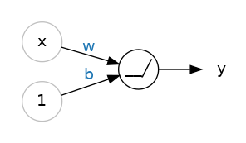
MLPs
Input 128 64 1
ReLU activation functions, sigmoid outer layer for binary classification
Used early stopping and dropout after each hidden layer
Tried Optuna to hypertune - took too long

Slide 33
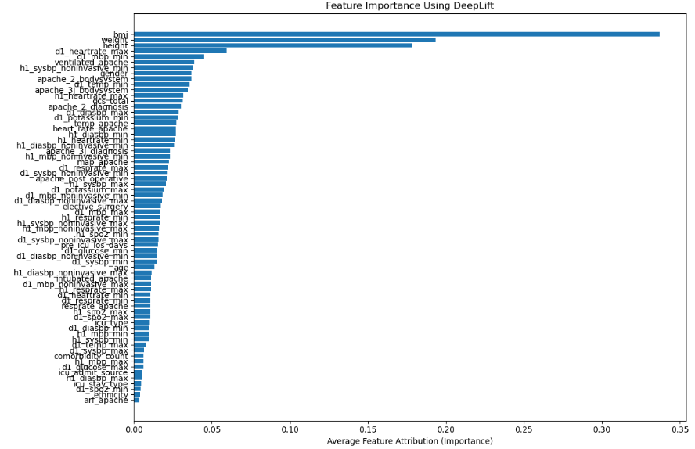
MLP - Feature Importance

Slide 34






Best Model:
MLP with SMOTENC
Accuracy: .9271
Precision: .9457
Recall: .9018
F1-Score: .92
ROC AUC: .985
PR AUC: .9837
Threshold adjusting not required!

Slide 35
Extensions

Slide 36

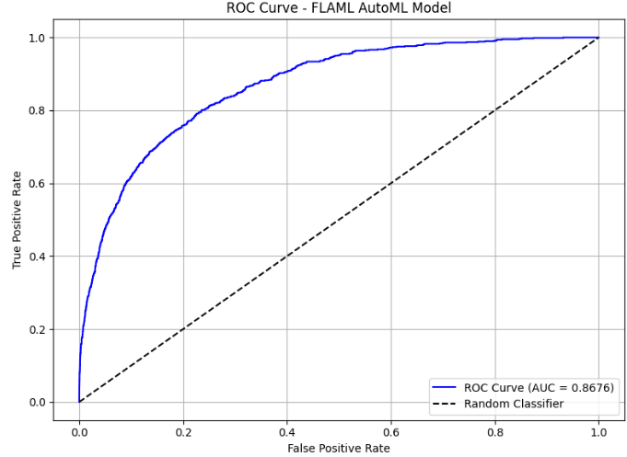
AutoML Using FLAML
Best Model: XGBoost classifier
220 Trees with a max leaves of 128
65% of features used each tree
Learning Rate: .12
Accuracy: .92
Precision: .61
Recall: .30
Overall - a flexible and complex tree

Slide 37
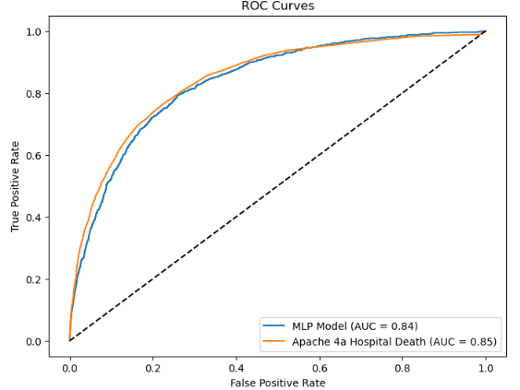
Our Model vs APACHE
MLP with SMOTENC
Accuracy: .86
Precision: .31
Recall: .58
ROC AUC: .8430
APACHE
Accuracy: .90
Precision: .44
Recall: .41
ROC AUC: .8457

Slide 38



Reinforcing Our Observations
Our best predictive models yield the following as the primary factors influencing ICU mortality :
Age, GCS, BMI.
Can these conclusions be supported by existing research?
Leveraged publically available medical literature on PubMed
Database contains > 37 million citations and abstracts.
Notes:
-We now have our best predictive models, and generally, they yield the following as the primary factors influencing ICU mortality - Age, APACHE score, GCS, BMI.
-Having said that, we wanted to check if these conclusions could also be supported by existing research. For this, we leveraged publically available medical literature on PubMed, whose database contains >37 million citations and abstracts.

Slide 39


Reinforcing Our Observations
The process was as follows :
Retrieved abstracts for the top 200 PubMed articles
based on the query (e.g. '"ICU Mortality" AND ("Age" OR "Glasgow Coma Scale" OR "GCS" OR "BMI" OR "Height" OR "Weight")')
via the PubMed API.
The top 50 most relevant articles were found
by calculating the cosine similarity score b/w each abstract and our query.
The query and abstracts were embedded using the AllenAI SPECTER model.

Slide 40
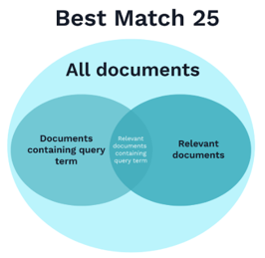


Reinforcing Our Observations
The top 3 sentences most relevant to the query were ranked and extracted from each abstract, using the BM25 algorithm.
The extracted top 3 sentences were passed to a Hugging Face BART model for summarization.
The summaries, along with the extracted sentences and original PubMed IDs, were saved to a CSV file.

Slide 41
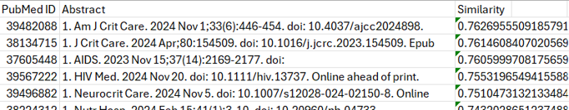
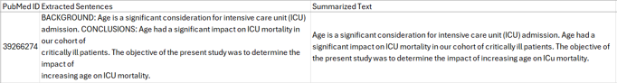
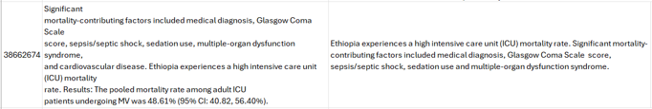
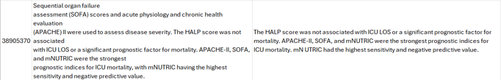
Reinforcing Our Observations
Cosine similarity scores output for the top 50 most relevant PubMed articles.
Some examples of summarized articles that back up our findings.

Slide 42

05
Lessons/
Conclusions

Slide 43
What Model is Best at Predicting Hospital Deaths?
MLP with SMOTENC
Accuracy: .9271
Precision: .9457
Recall: .9018
F1-Score: .92
ROC AUC: .985
PR AUC: .9837
For all models we can adjust threshold to balance precision and recall
results in Low False Negatives at expense of more False Positives
Most important features: Age, ventilated, Glasgow Coma Scale Total

Slide 44

Lessons Learned
Preprocessing is hard and takes time:
feature engineering helps combat the curse of dimensionality
Addressing class imbalance is crucial for improving model performance on minority classes
Balancing recall and precision requires careful consideration to avoid overwhelming resources with false positives

Slide 45

Future Work
Look at feature interactions and other ways to perform dimensionality reduction to capture complex relationships
Utilize techniques like Grid Search or random search to fine-tune model parameters for optimal performance
Conduct fairness assessments to ensure the model does not inadvertently introduce biases, especially after collapsing ethnic categories

Slide 46
Thank You!
Questions?

